Slide 1
Make your own A.G. (ASCII Galaxy)
NASA Space Apps Challenge 2025
MINWOO GO
MINYEONG KA
HYEONMO KU

Slide 2
Flow
Receive hyperparameters
→ A machine learning model selects the most proper galaxy
머신 러닝 모델이 하이퍼 파라미터에 해당되는 은하를 추천
converts the 2D galaxy image(fits file) into a 3D image (NumPy array)
2d 은하 이미지를 3d 이미지(numpy 배열)로 변환
Output the 3D image (NumPy array) as ASCII art
3d 이미지(numpy 배열)를 아스키아트로 출력

Slide 3
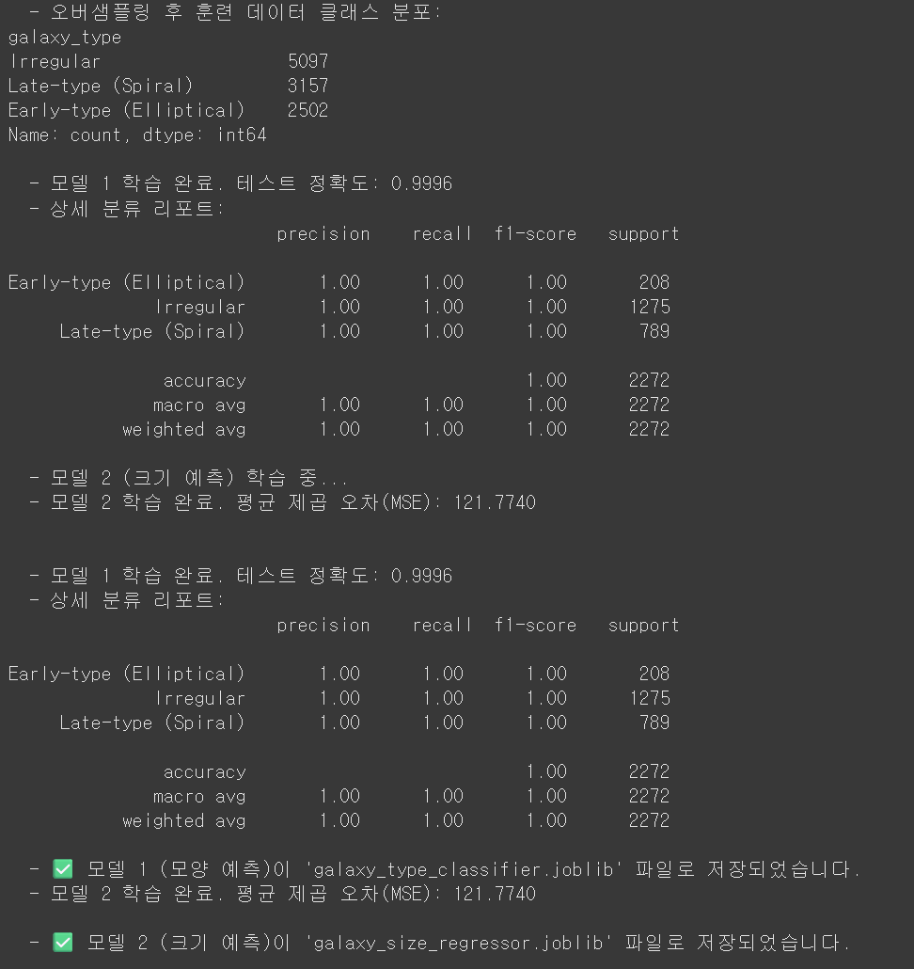
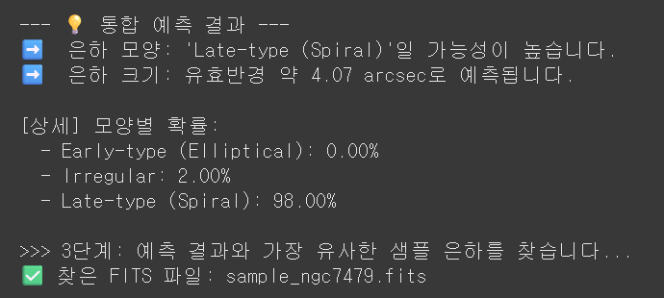
Step 1
Receive hyperparameters
Sersic number, Ba ratio, Speed distribution, Total star formation rate, Redshift, Surface brightnes
Proper galaxy prediction
machine learning(shape, size)
generate a 2D galaxy image (NumPy array)
Select similar galaxy from the data

Slide 4
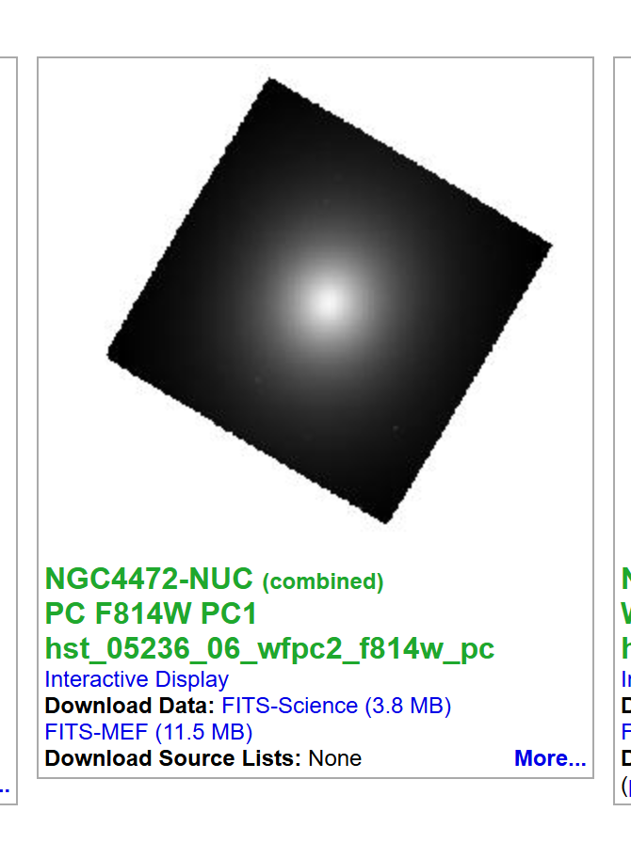
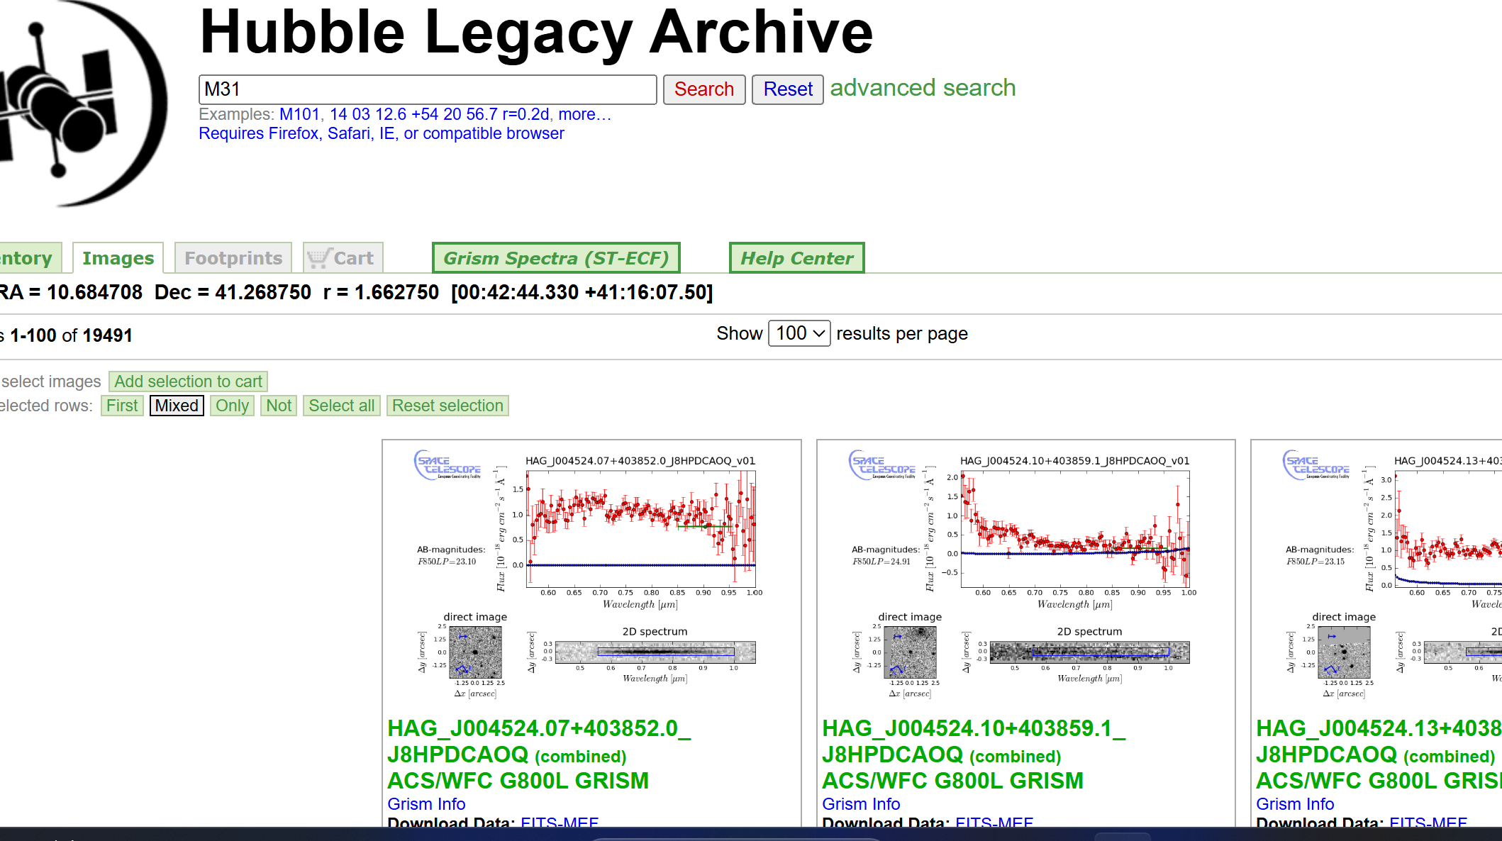
Step 2
Convert the selected 2d image into 3d image
The depth is calculated by the brightness of a cell

Slide 5
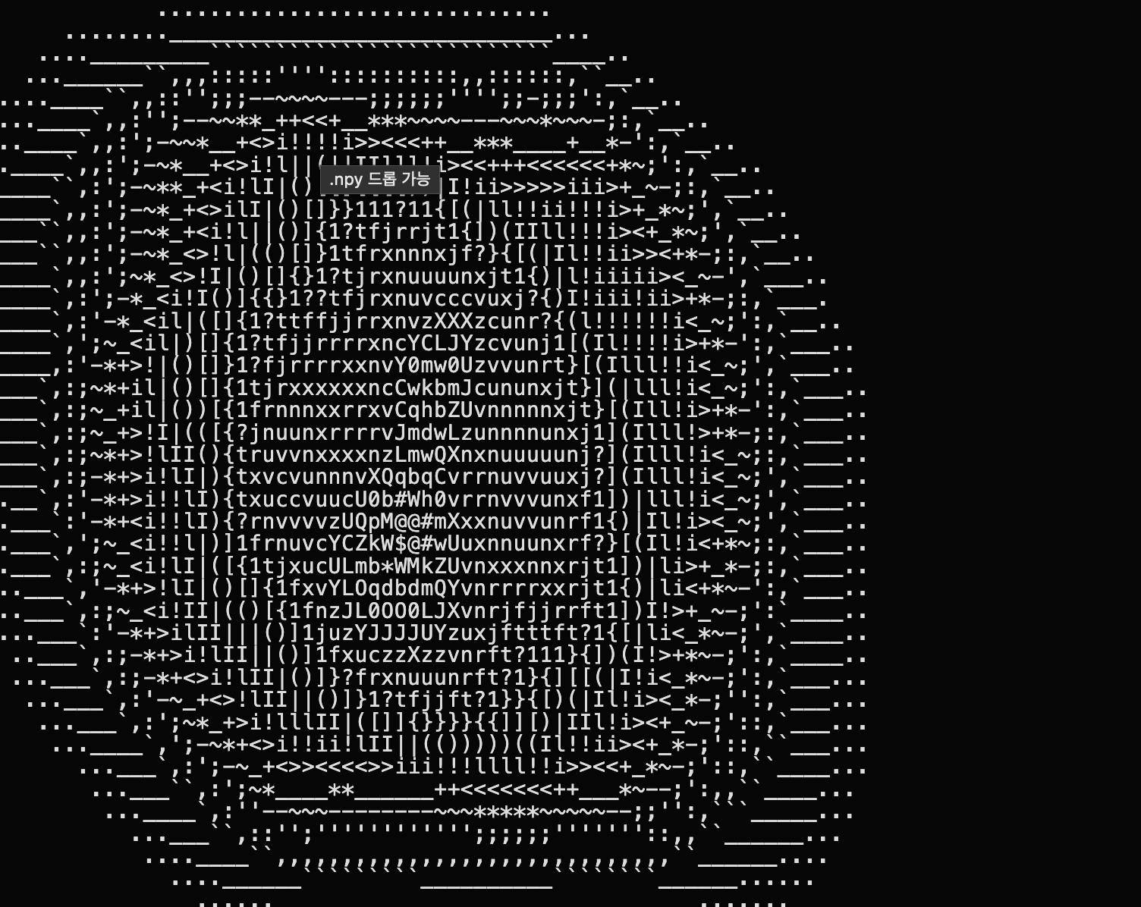
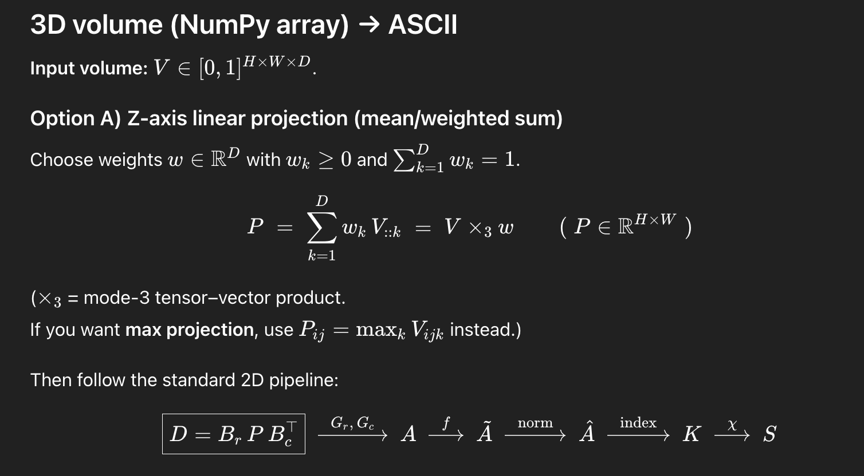
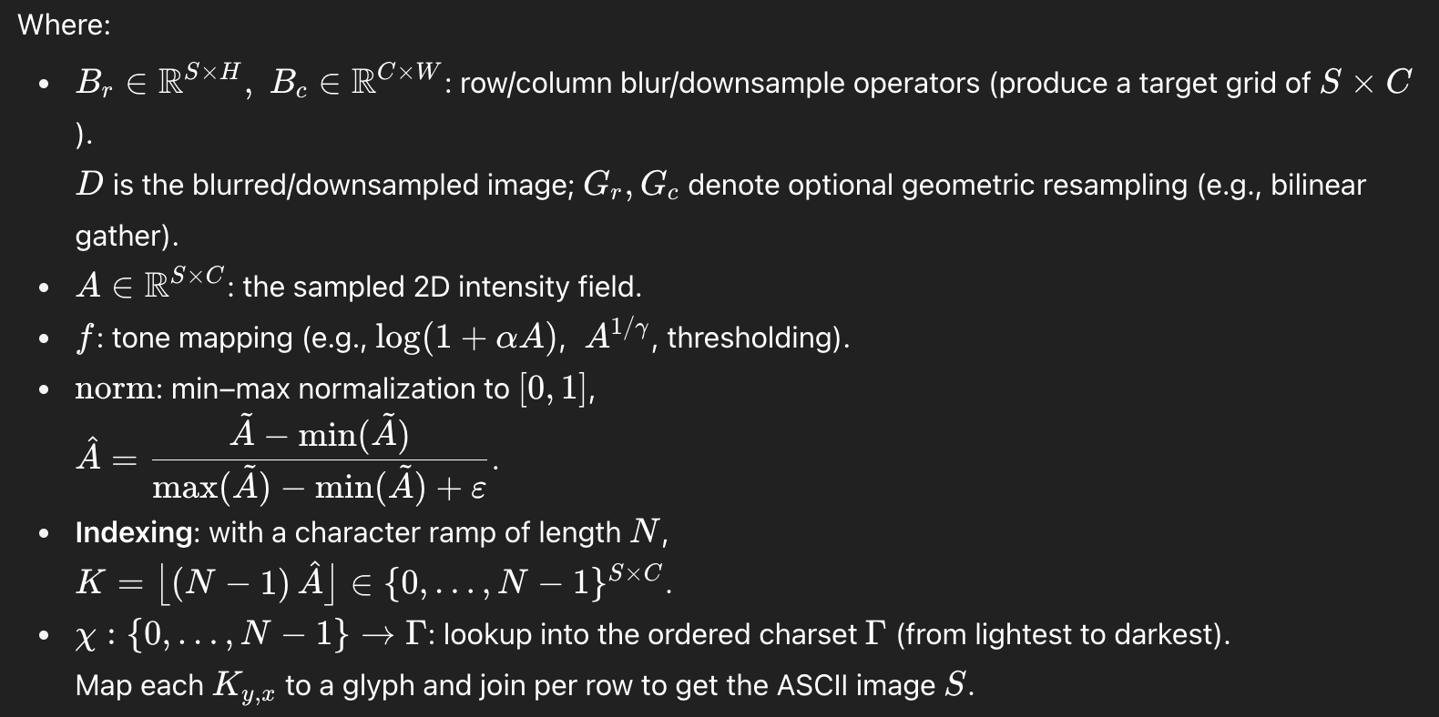
Step 3
Output Convert the 2D image and 3D image (NumPy array)
Into ASCII code Art
3d 이미지(numpy 배열)를 아스키아트로 출력

Slide 6
Work(동작화면 1)
Spiral Galaxy
Elliptical galaxy
You can manipulate wi

Slide 7
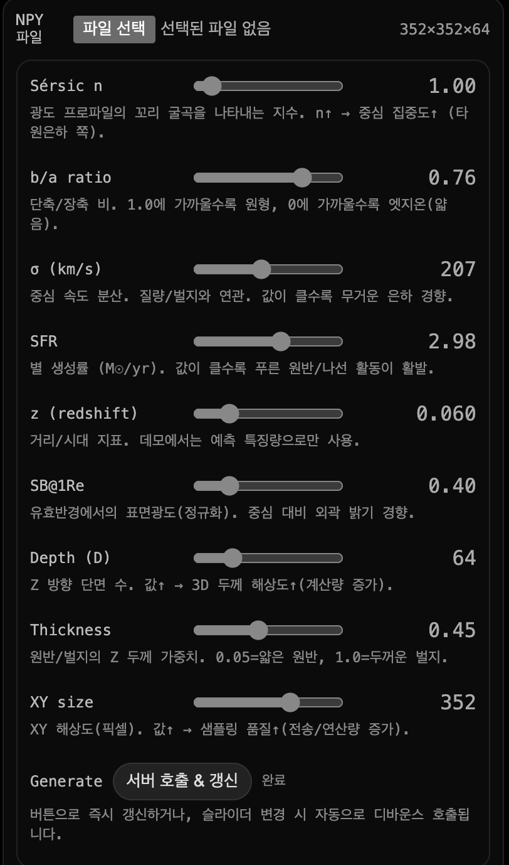
Work(동작화면 2)
You can manipulate with parameters

